Slide 1
Fudgemart/Fudgeflix Integrated Sales Analysis

Slide 2
Introduction

Slide 3
Group 4 - Who are we?
Eamon Gallagher
Warren Fernandes
Sarang Bakshi
Shubham Kumar

Slide 4
Look at the Data
FudgeMart
Fudgemart is a fictitious online retailer, similar to Amazon.com or Walmart.com. The database consists of customers, products and vendors, and has familiar business processes you would find in any online retailer.
FudgeFlix
Fudgeflix is a fictitious online DVD by mail and video on demand service, similar to Amazon instant video or Netflix. It contains concepts such as accounts, subscriptions and video titles as well as other things associated with an online video streaming service.

Slide 5
Problem
Fudgemart and Fudgeflix require a new BI solution for their sales process. They require an integrated data warehouse that preserves information from the database schema of both companies.

Slide 6
Goals
The key requirement of this project is a queryable, user friendly warehouse that stores facts on sales and relevant context.
In order to improve the sales process for FudgeFlix and Fudgemart, the group set forth the following approached the problem in the following steps:
Define Data rules to combine data from FF & FM
Set up ETLs for OLTP >> Stage
Set up ETLs for Stage >> DW
Create MOLAP
BI

Slide 7
Data Rules
To combine the stage data from FF & FM we have defined some rules, as follows:
Customers in FM & Accounts in FF are similar, they will belong to DimCustomer in DW
Products in FM & Plans in FF are similar, they will belong to DimItem in DW
Order quantity is assumed to be 1 for FF
We assume the ab_billed_amount in FF as the retail price
For FF wholesale price is half of the retail price(ab_billed_amount)

Slide 8
Staging
Information from Fudgemart and Fudgeflix were loaded into separate stage tables. In total there were 2 dimensions and one fact staged for each company. The dimensions were merged when loaded to the DW in the following fashion:
DimCustomer: stgFMCustomers, stgFFAccounts
DmItem: stgFMProducts, stgFFPlans
FactSales: stgFMSales, stgFFBills
*Many data types were changed after being loaded to stage table to match the destination tables.

Slide 9
Star Schemas

Slide 10
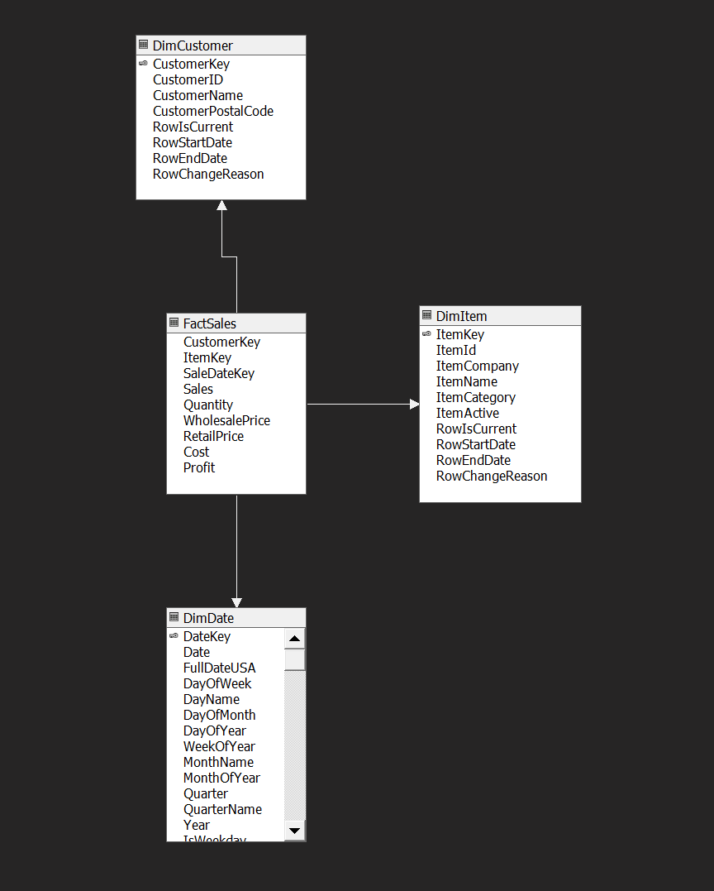
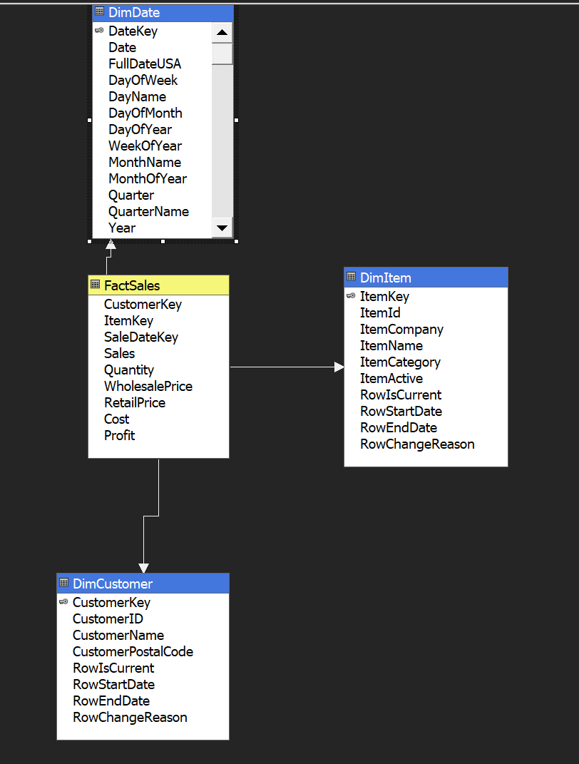
ROLAP
MOLAP

Slide 11
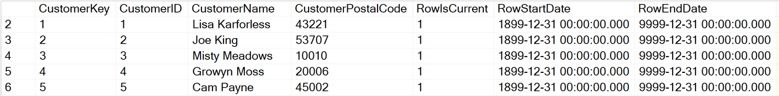
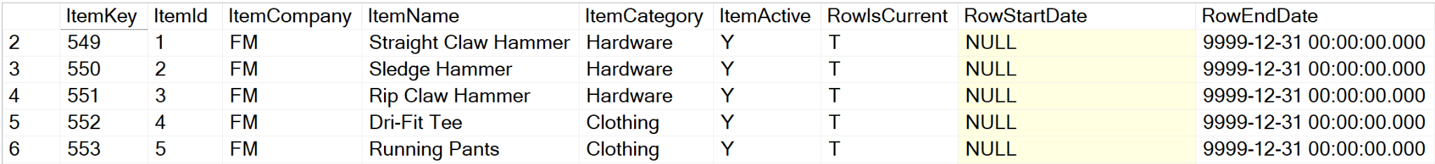
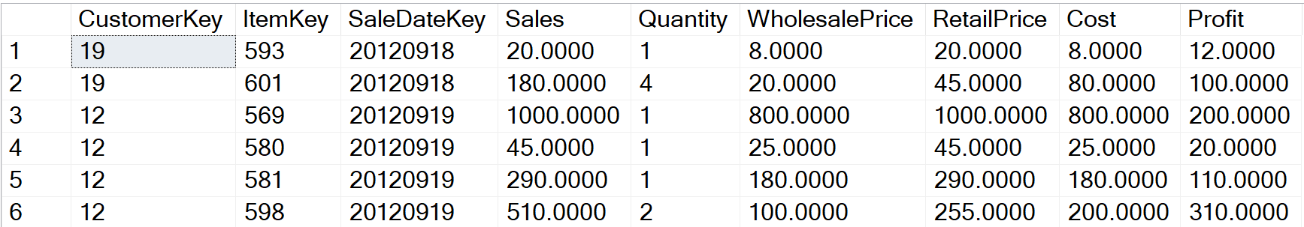
Facts and Dimensions
DimCustomer
DimItem
FactSales

Slide 12
Business Intelligence

Slide 13
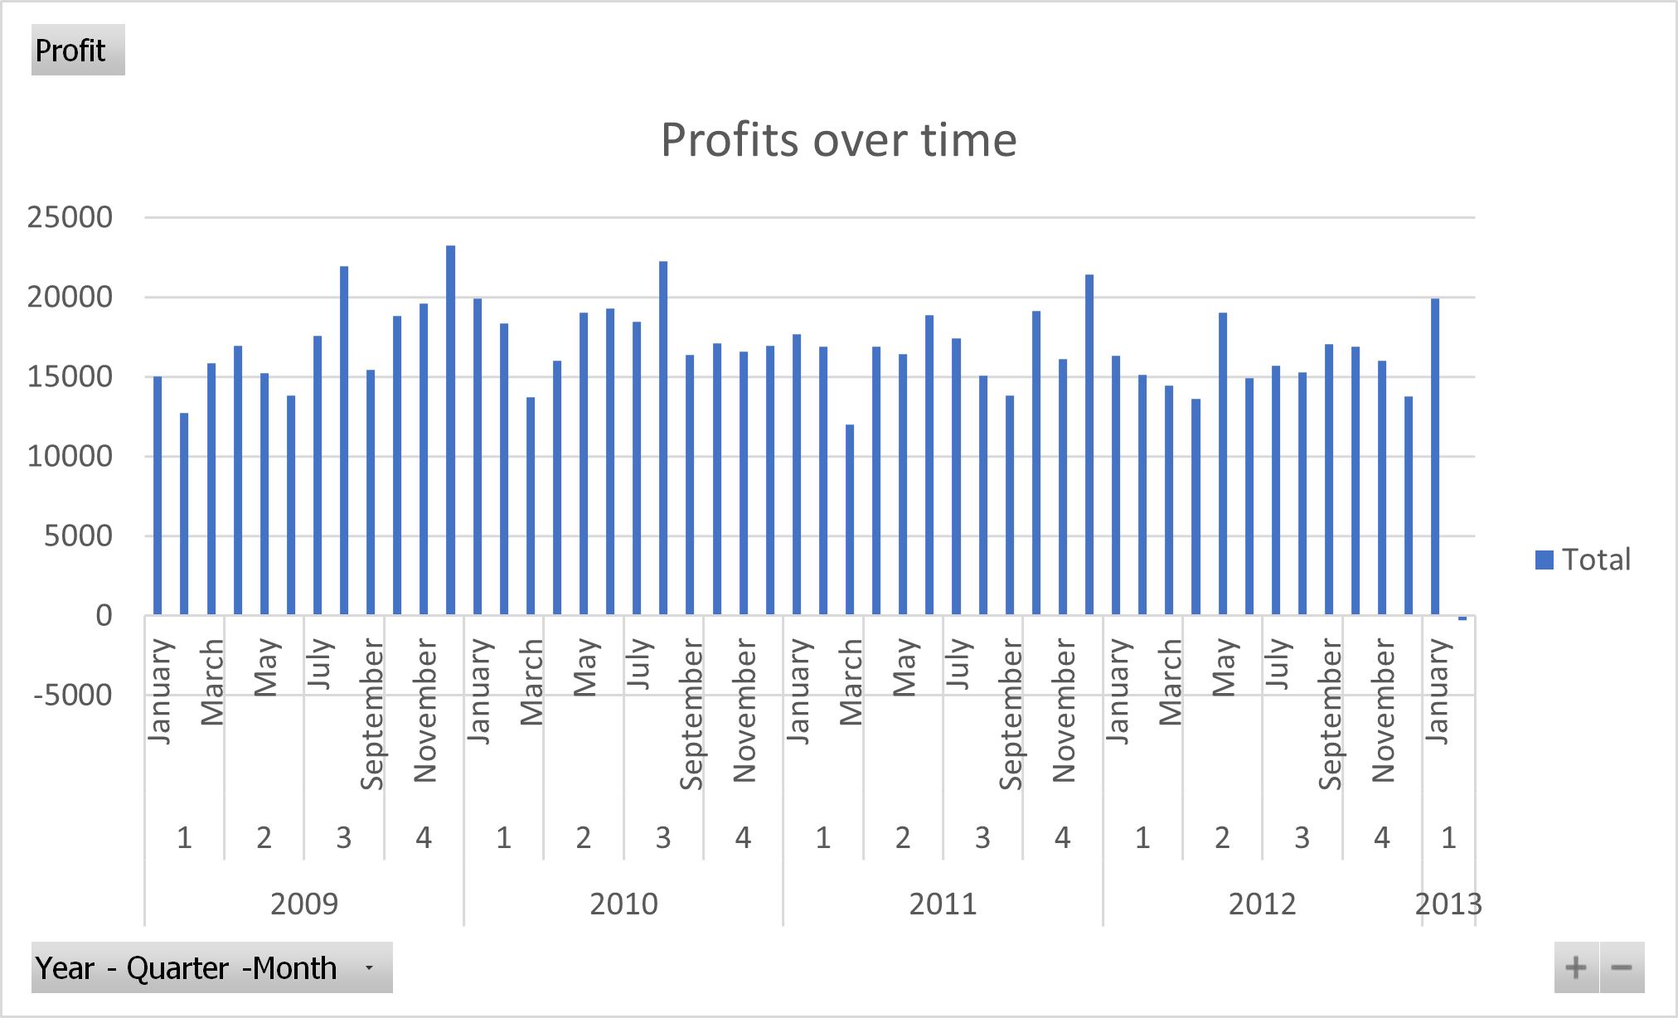

Slide 14
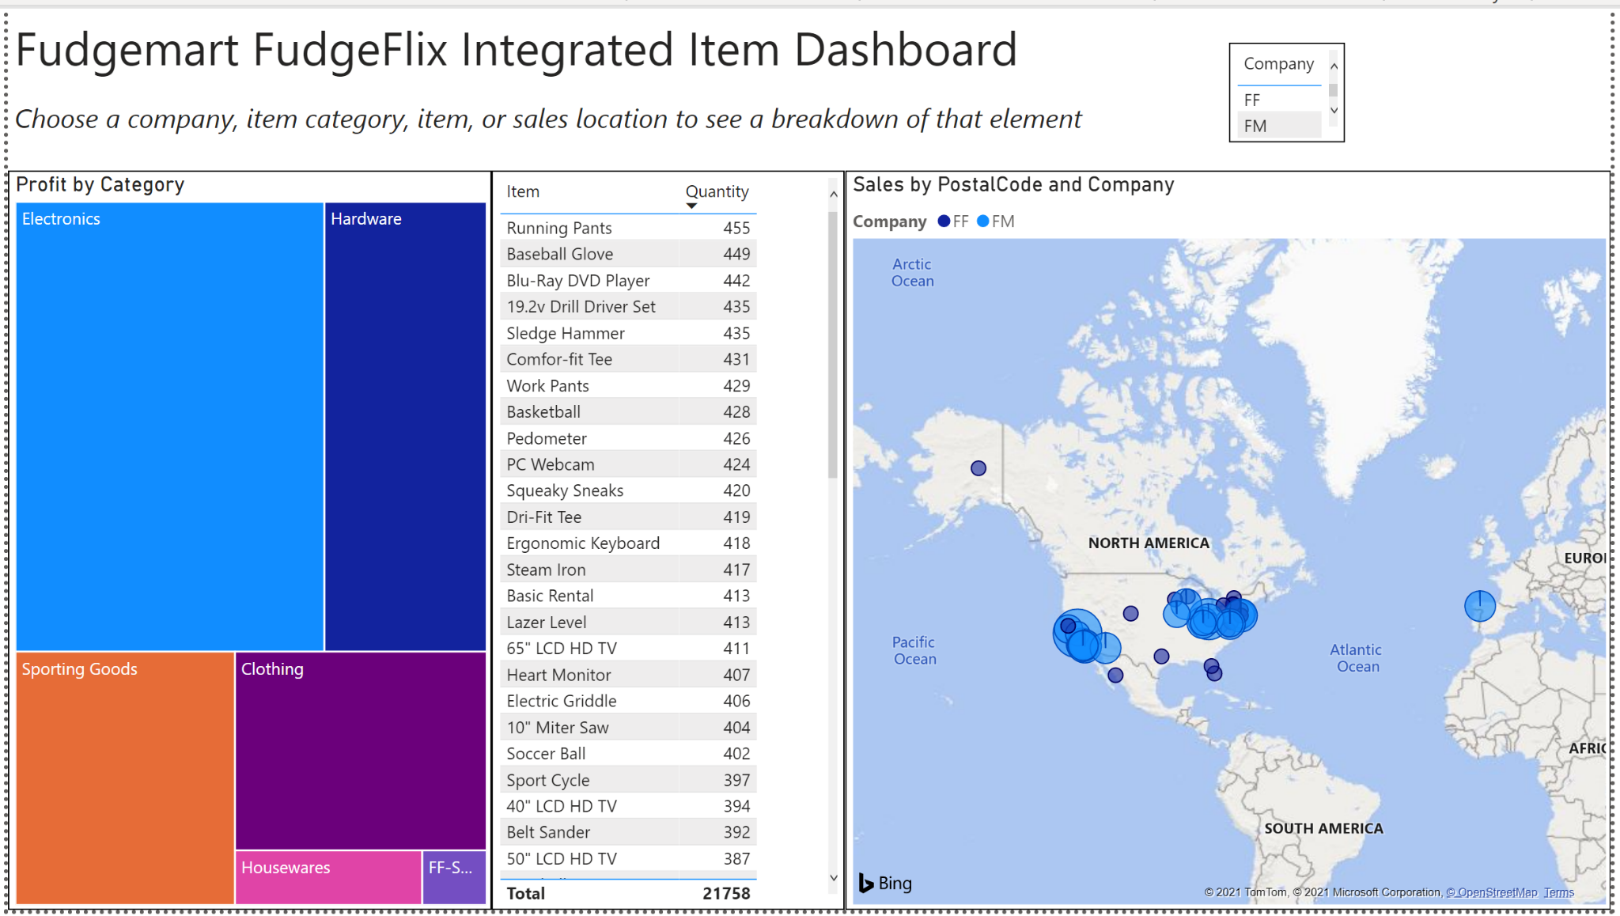
Dashboard

Slide 15
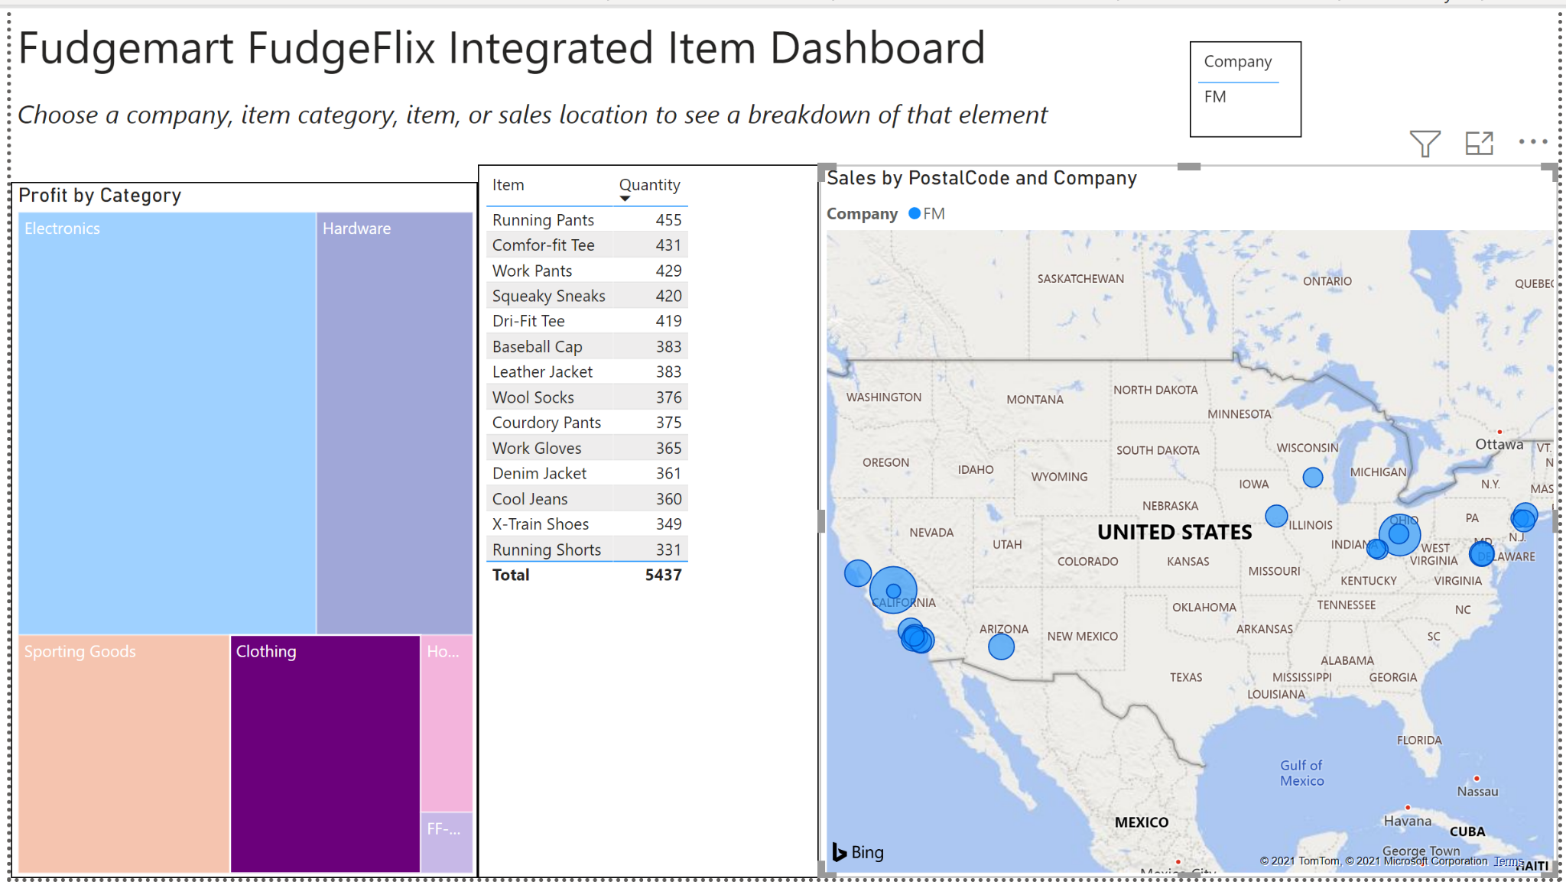
See top selling items, regions for each category.

Slide 16
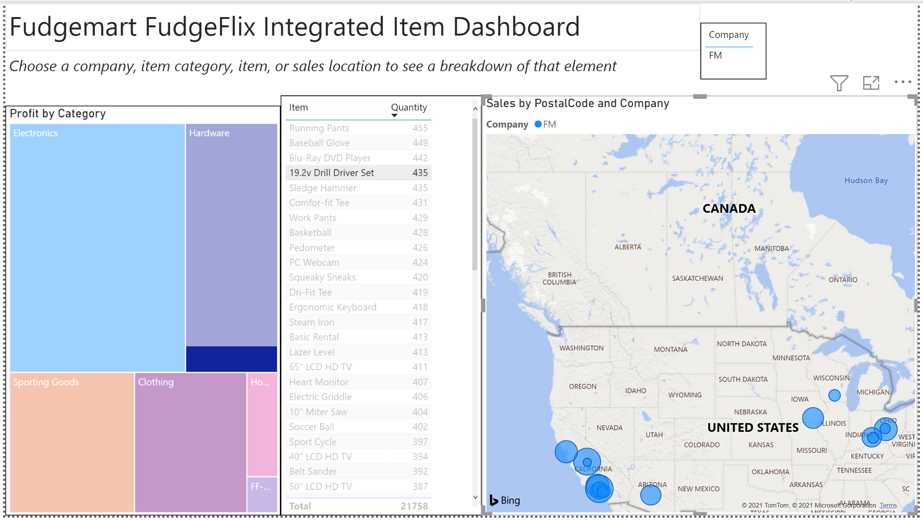
See regions of interest and percentage of category profit for each item

Slide 17
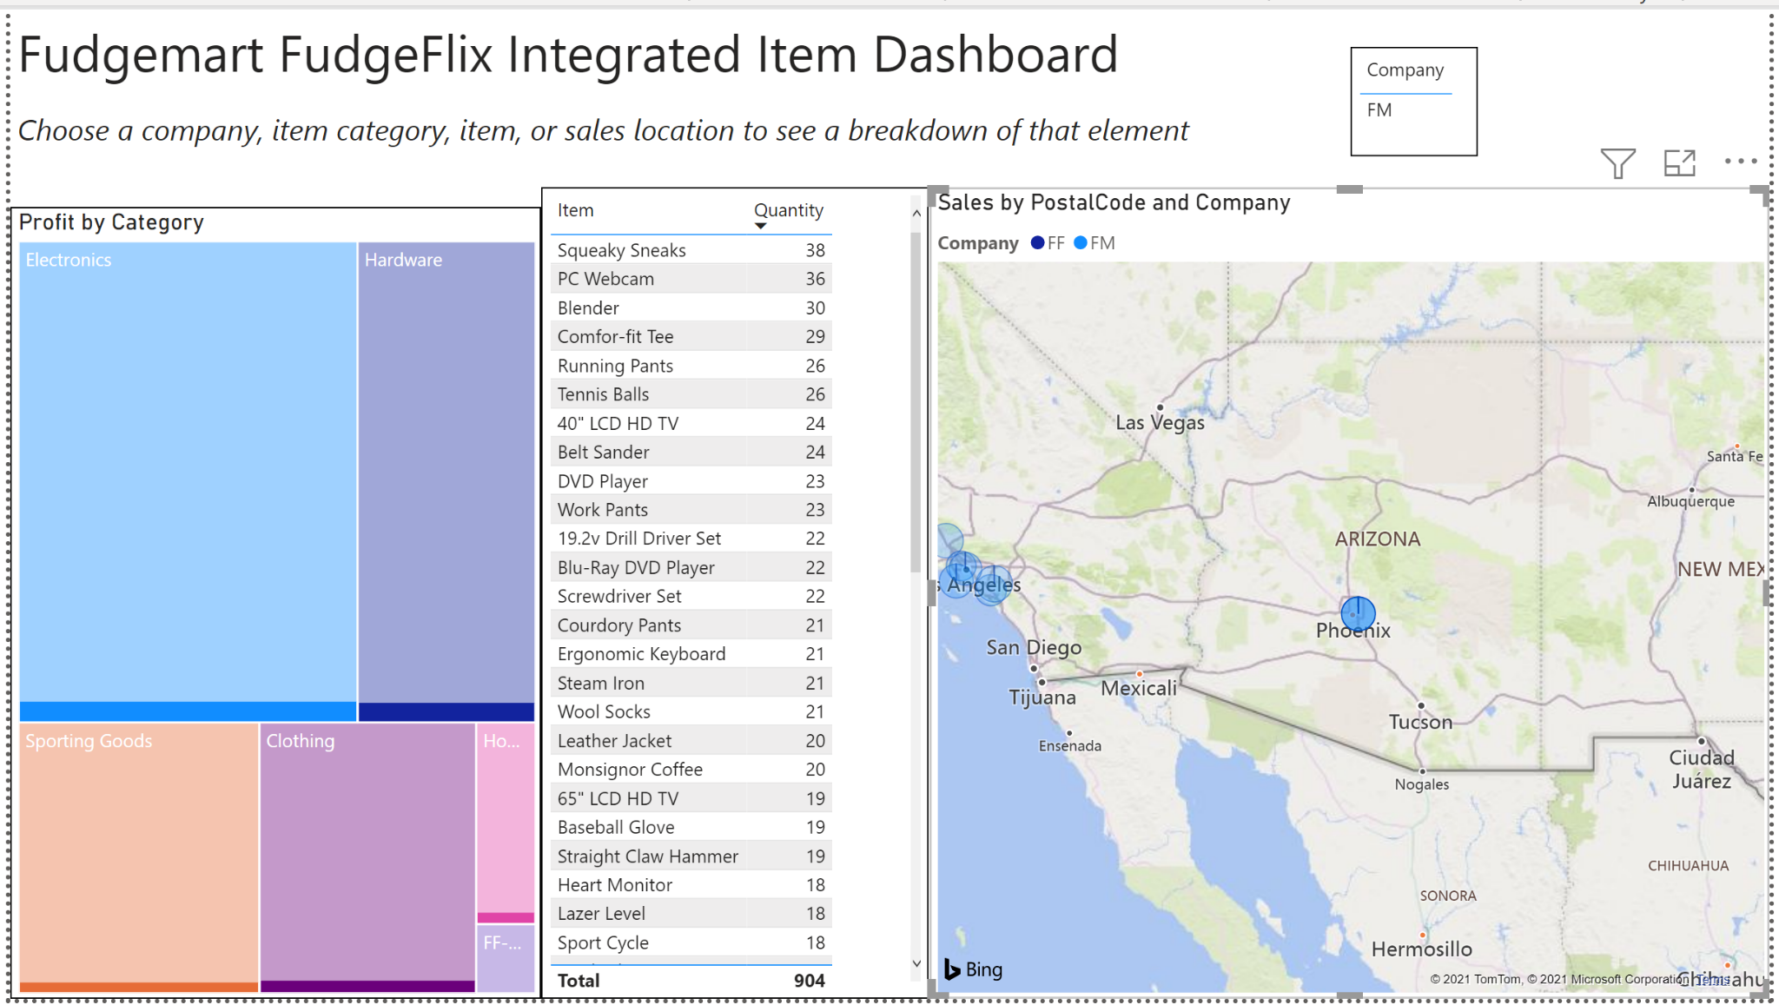
Choose a zip code to see the most profitable categories and best selling items.

Slide 18
Insights and Recommendations

Slide 19
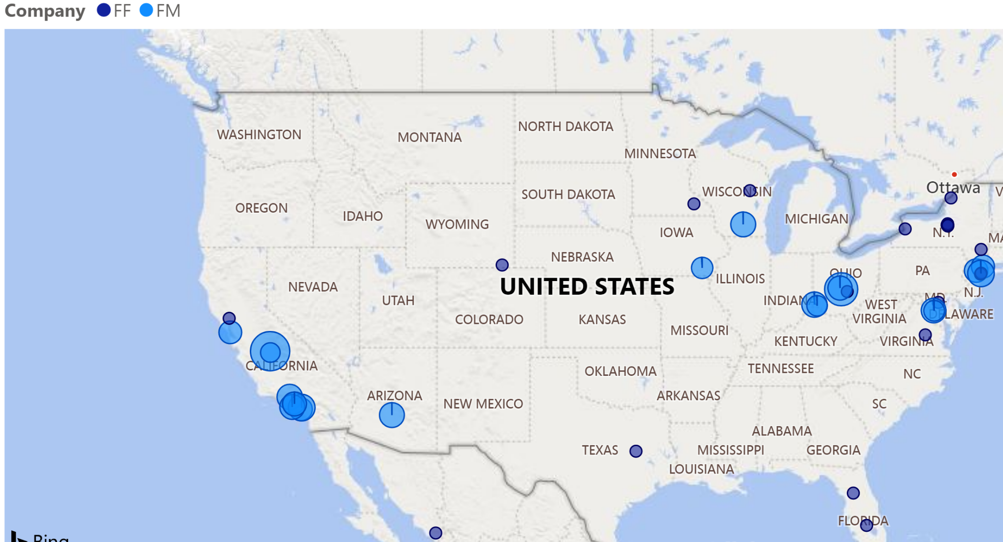
Both companies need to improve their reach
Fudgemart operates mostly in California and the Northeast.
Sales inland in Iowa, Wisconsin and Arizona. What do we need to increase sales in these regions? More locations? Better distribution?
Fudgeflix is better spread out but accounts for fewer sales. Streaming, as an online service, could be a way for the company to expand. Then again, streaming may only be a trend.

Slide 20
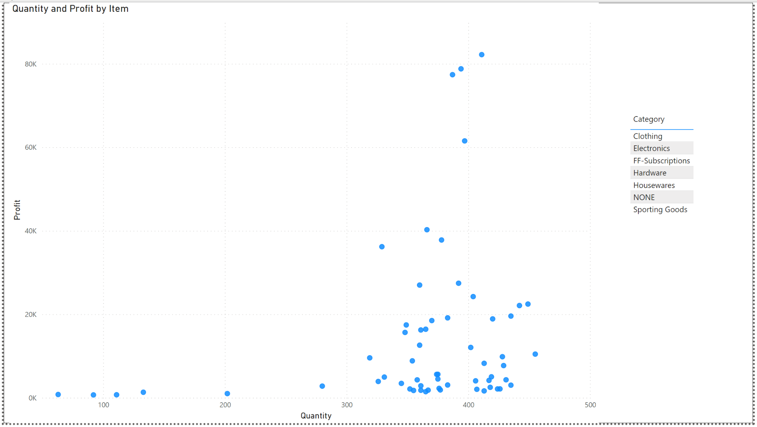
Some products produce high profits in relation to the quantity sold

Slide 21
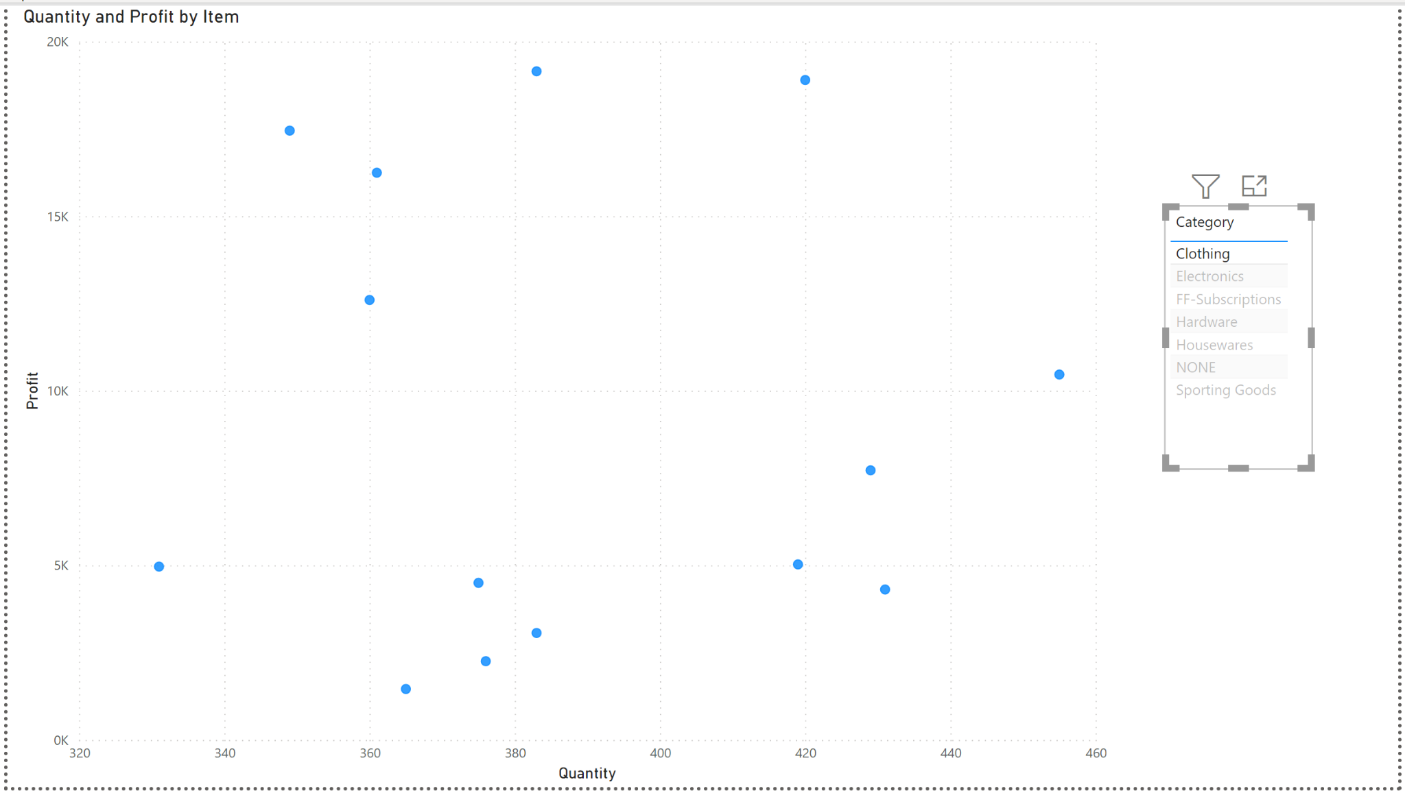
For clothing this includes X-train Shoes, Leather Jacket and Denim Jacket
Denim Jacket
X-train Shoes
Leather Jacket
Comfor-fit Tee

Slide 22
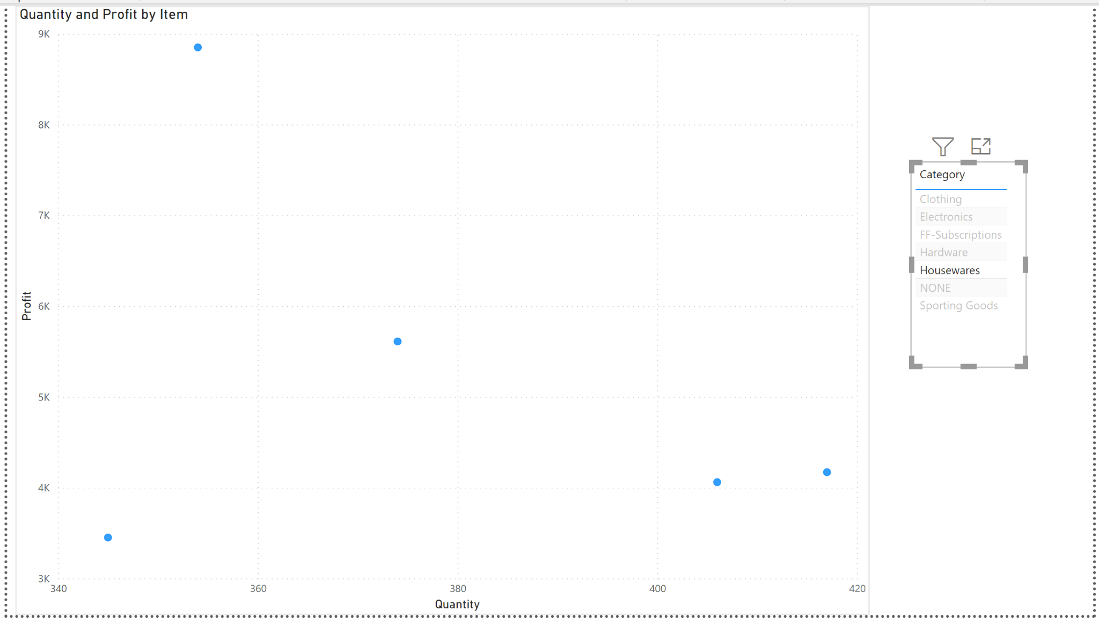
For houseware, the blender was extremely profitable
Blender
Steam Iron
Electric Griddle

Slide 23
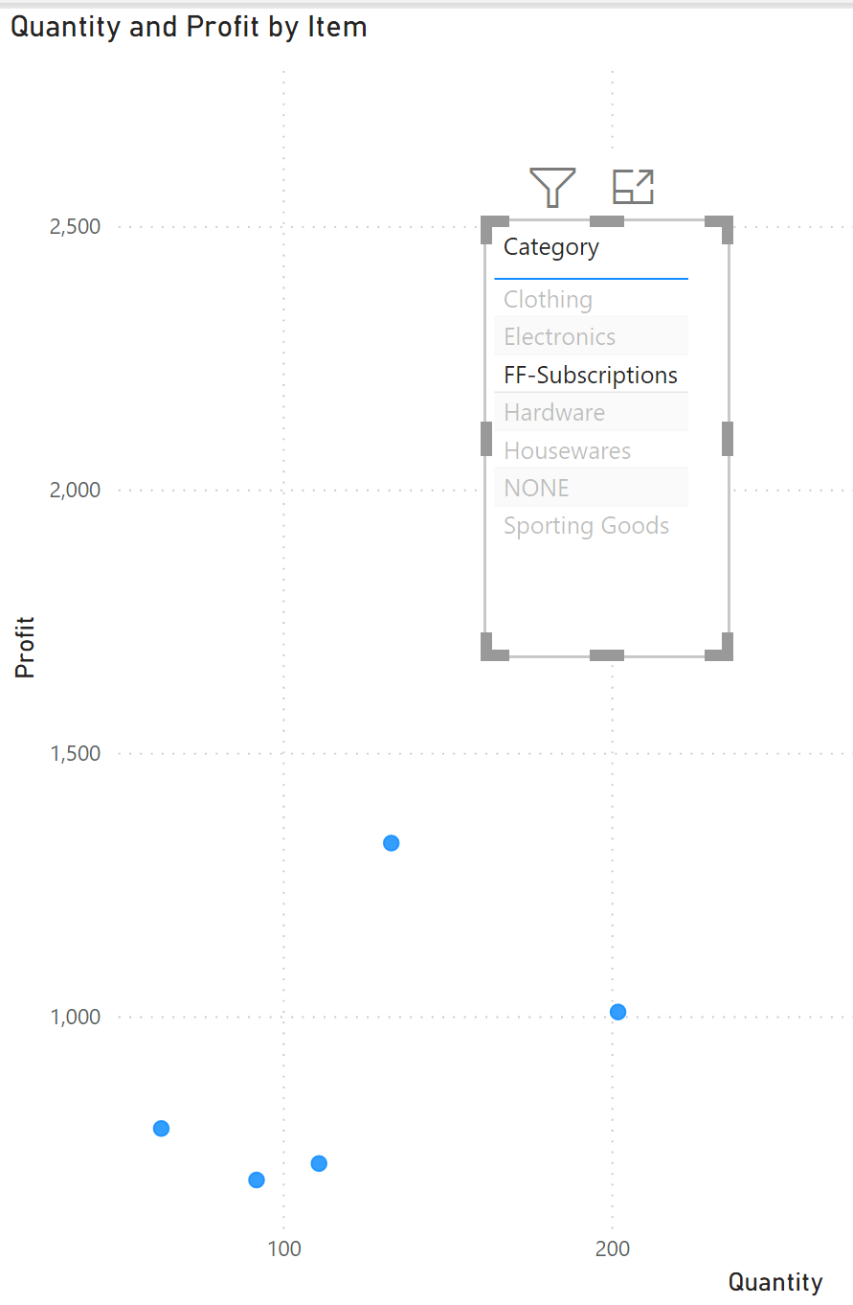
Both Fudgeflix and Fudgemart should market their more profitable items and move away from less profitable items with higher volume
Premium Rental
Basic Rental

Slide 24
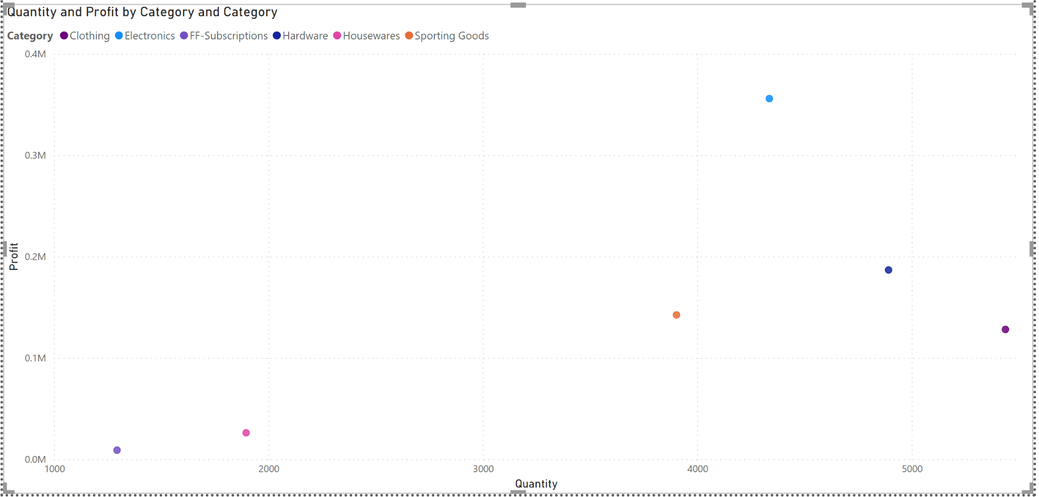
To take this concept a step further, some item categories are more profitable than others in relation to quantity sold.
Electronics
Clothing

Slide 25
Summary
Both Fudgemart and Fudgeflix should expand their reach. For Fudgemart this could take the form of improved distribution. For Fudgeflix, alternate services such as streaming could provide quality revenue.
For each of these companies’ catalogues, there are more and less profitable items. Companies should increase marketing of profitable items while moving away from unprofitable items.
The same goes for item categories. Electronics accounts for a high volume of profits and should be a focal point going forward. Clothing sells in high quantities but isn’t profitable enough to justify its required logistics.

Slide 26
Conclusions

Slide 27
Building a mature DW enabled better/efficient BI
Defining data rules is important for the organization to agree on Data use
With a well built ETL pipeline, there are no hiccups in moving data from OLTP to DW
It would have been nice to have an equivalent value for wholesale price for Fudgeflix plans. Would allow us to better understand if some FF plans were more profitable than others.

Slide 28
Thank You!
Questions?

